Slide 1

Studii AI: Your Smart Study Companion
Revolutionizing last-minute exam preparation for students worldwide.

Slide 2
The Last-Minute Study Struggle
Students often face overwhelming pressure, limited time, and disorganized materials just days before exams. Traditional study methods are inefficient, leading to stress and suboptimal performance.
Information Overload
Time Crunch
Lack of Focus
Too many notes, PDFs, and presentations to review effectively.
Limited days before exams make comprehensive revision seem impossible.
Difficulty prioritizing key topics for efficient study sessions.

Slide 3

Introducing Studii AI: The Intelligent Edge
Studii AI simplifies and centralizes revision, offering a comprehensive, AI-powered platform designed for efficient last-minute exam preparation.

Slide 4



Effortless Content Transformation
Upload your study materials, and Studii AI instantly transforms them into dynamic learning aids.
Flashcards
Quizzes
Mind Maps & Flowcharts
Generate interactive, swipeable flashcards for quick memorization.
Create custom quizzes to test your knowledge on specific topics.
Visualize complex concepts with AI-generated mind maps and flowcharts.

Slide 5





Core Features for Success
Studii AI integrates essential tools to support every step of your study process.
Home Dashboard
Doubt Chatbot
Progress Tracker
Personalized greeting and quick access to study materials.
Instant AI-powered answers to your study questions.
Visualized performance insights through interactive graphs.
Leaderboard
Planner
Motivating rankings with avatars to foster healthy competition.
Integrated calendar for setting and tracking study goals.

Slide 6
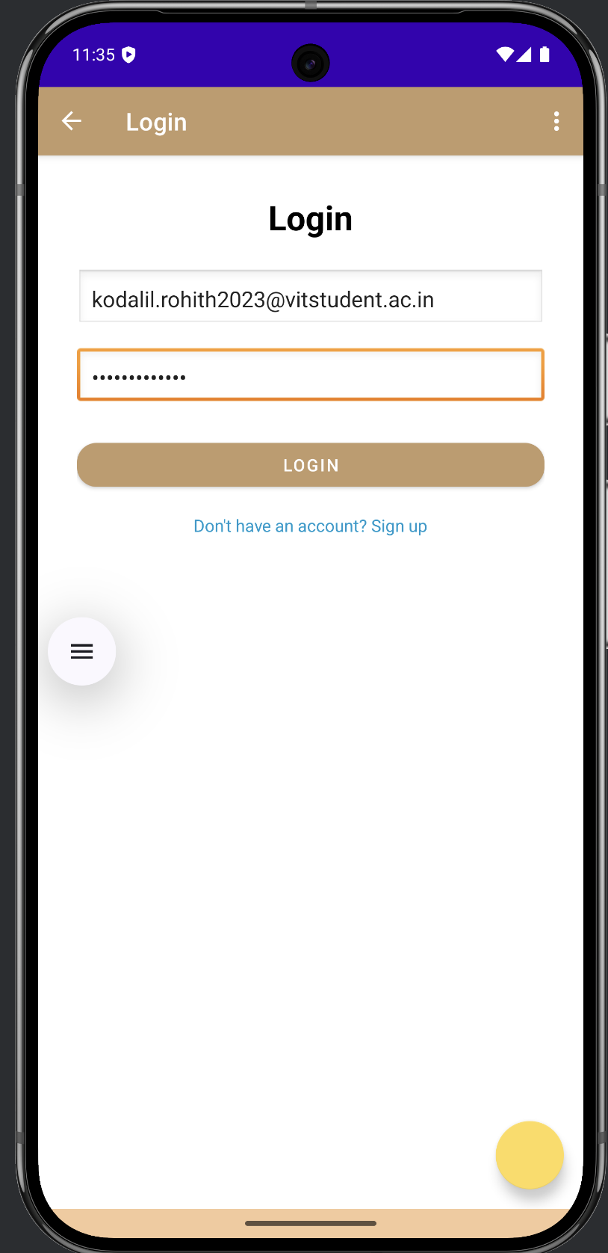
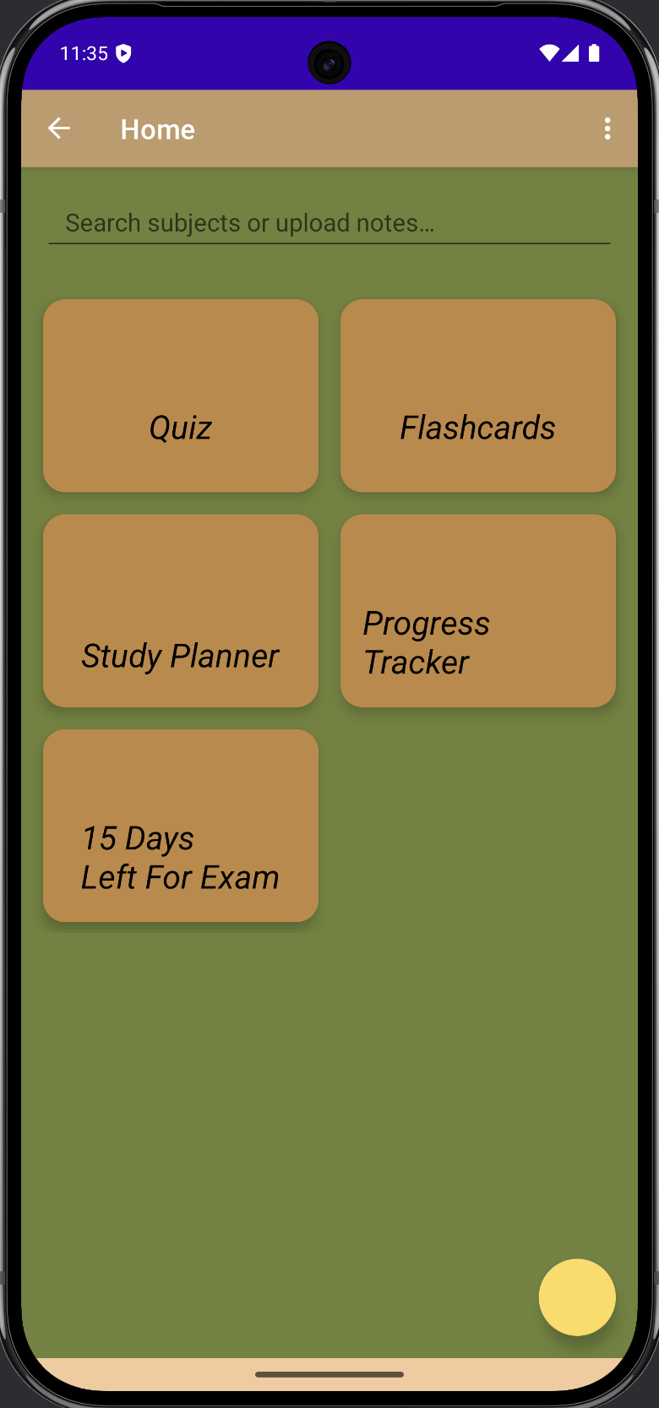
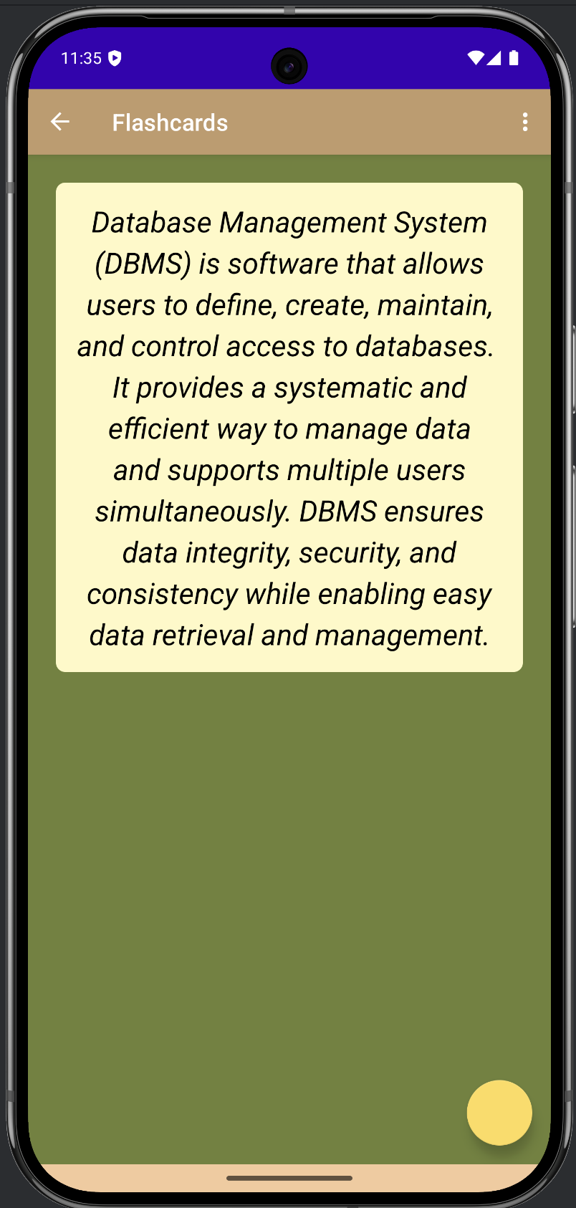
Seamless User Experience

Slide 7
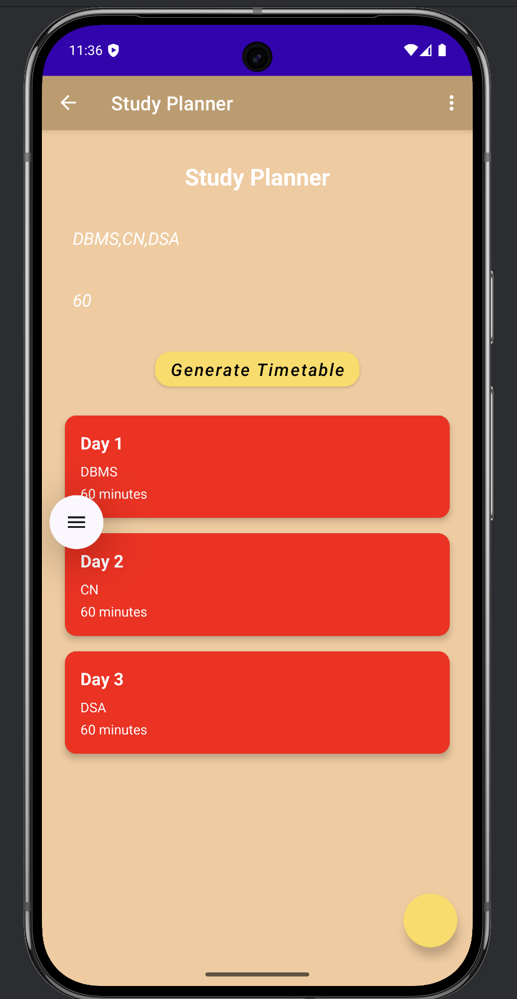
Your Personalized Study Journey
Studii AI crafts a dynamic study plan tailored to your unique needs and exam schedule.
Intelligent Planning
Time Remaining: Optimizes study hours based on your exam countdown.
Topic Weightage: Prioritizes high-value areas for maximum impact.
Progress Tracking: Adapts plans based on your performance and activity.

Slide 8




Why Studii AI?
Studii AI transforms last-minute studying from a daunting task into a streamlined, effective process.
Efficiency Boost
Personalized Learning
Automates material summarization, saving precious study time.
Adapts to individual needs for optimized study outcomes.
Performance Insights
Stress Reduction
Empowers students with data-driven progress tracking and motivation.
Provides clarity and structure, reducing pre-exam anxiety.

Slide 9
Vision & Roadmap
We are committed to continuous innovation, expanding Studii AI's capabilities and reach.
Phase 2: Feature Expansion
Phase 1: Core Launch
Integration of advanced AI features: voice-to-text notes, collaborative study modes, and gamified challenges.
Android app launch with AI summary tools and personalized plans.
Phase 4: Ecosystem Integration
Phase 3: Platform Growth
Partnerships with educational institutions and curriculum providers for seamless learning.
Web platform expansion, iOS app development, and global market entry.

Slide 10
Join Us in Empowering Students
We invite you to partner with Studii AI and revolutionize the way students prepare for success. Thank You

